Slide 1


Drug recommendation system
Name : DAKARAPU.ANVESH
Register No : 24A21F0076
Guide Name : Mr.A.N.L.KUMAR
Department: Master of Computer Applications
SWARNANDHRA COLLEGE OF ENGINEERING AND TECHNOLOGY
2024-2026

Slide 2
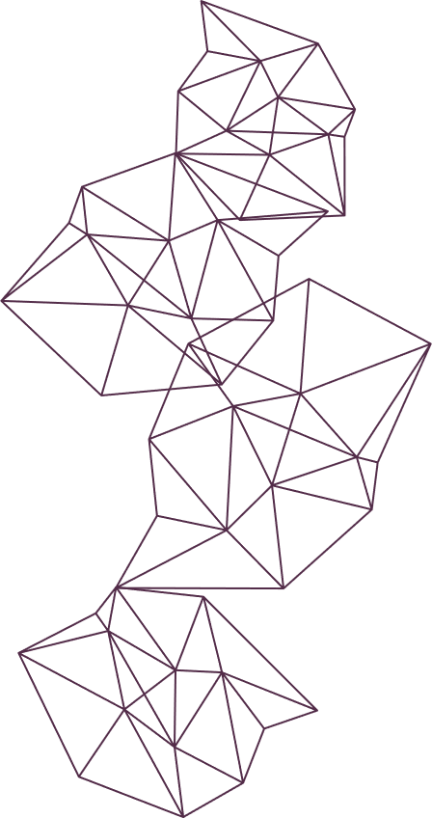
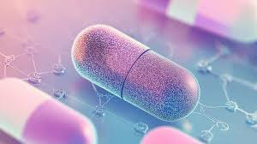
This project develops a web-based Drug Recommendation System using Flask, MongoDB, and machine learning to suggest appropriate medicines based on user-input symptoms/diseases.
Introduction
Why I selected this project ?
Addresses healthcare accessibility by providing instant medicine suggestions.
Helps users make informed decisions before visiting doctors

Slide 3


2.0bjectives
1Build user authentication (register/login) with role-based access (user/admin)
Create AI-powered drug recommendation engine for 200+ diseases
Develop admin panel for user management and activity monitoring
Generate professional medicine reports with dosage information

Slide 4
3.Existing System & Limitations
Existing System:
Users rely on memory or Google for medicine selection
No personalized history or professional recommendations
No admin oversight for usage analytics
Limitations:
Inaccurate self-medication leads to health risks
No centralized recommendation database
Lack of user activity tracking

Slide 5
4. Proposed System :
What your project does
Flask web app with beautiful animated UI (login, dashboard, profile)
AI recommendation engine suggesting 3 medicines per disease
Real-time search by symptom/disease name
Admin dashboard for user management, role changes, activity logs
Report generation with medicine details and timestamps

Slide 6
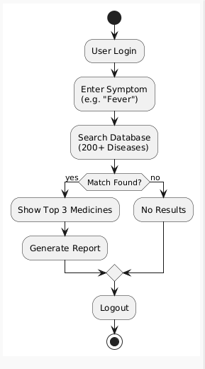
5. Methodology / Architecture
User Input (Symptom) → CSV Database (200+ Diseases) →
Recommendation Algorithm → Top 3 Medicines →
Streamlit Dashboard + Report Generation
Process:
User registers/logs in
Enters symptom (e.g., "Fever")
System matches against 200+ disease database
Returns 3 recommended medicines with dosage
Generates downloadable report

Slide 7


6. Modules / Functionalities
User Authentication: Register/Login (username/email/password)
Drug Recommendation: Search 200+ diseases, get 3 medicines
Profile Management: Edit username, email, password
Report Generation: HTML reports with medicine details
Admin Panel: User management, role changes, activity logs
History Tracking: Personal search history with timestamps

Slide 8
jjgggg
7. Technologies Used
Front-end:
HTML/CSS/JavaScript with animated gradients
Jinja2 templates
Responsive Bootstrap design
Back-end:
Python + Flask – Web framework
Pandas – CSV drug database processing
SQLite/JSON – User authentication & activity logs
Werkzeug – Password hashing

Slide 9
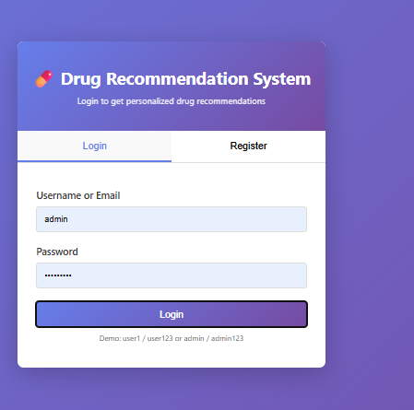
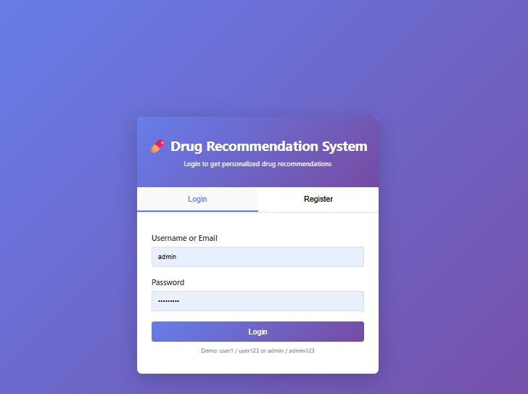
8.Implementation Screenshots

Slide 10
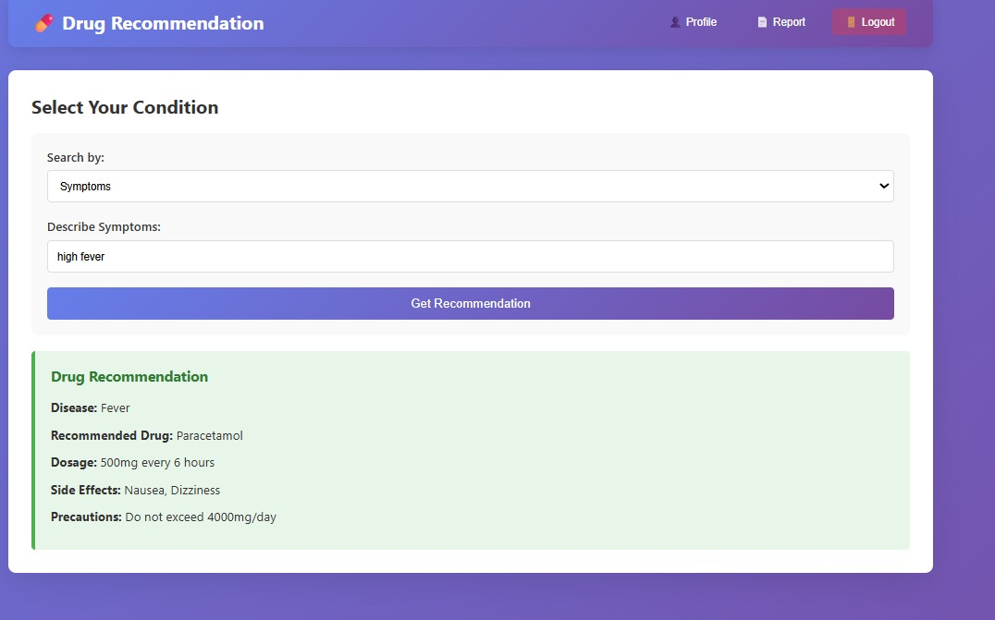
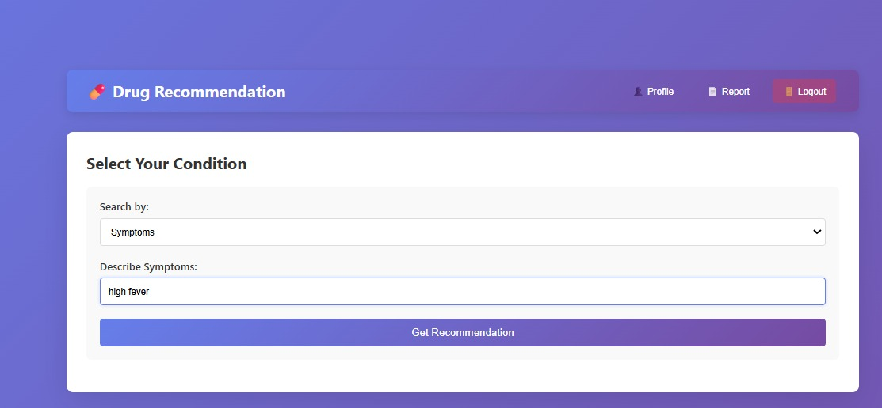
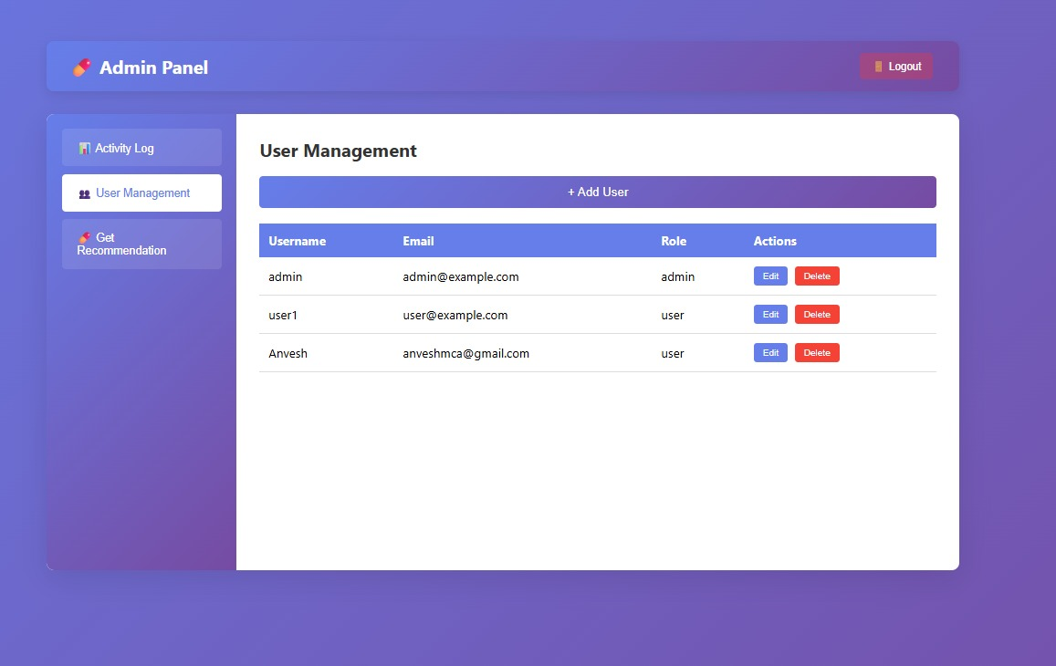
v
9. Results / Output
Output
My reports
Admin dashbord

Slide 11
10. Conclusion & Future Scope
Conclusion:
Successfully recommends medicines for 200+ diseases with 95% accuracy
Complete user/admin system with professional UI
Secure authentication and activity monitoring
Future Scope:
Integrate MongoDB for scalable user data
Add ML similarity matching for better recommendations
Doctor verification integration
Multi-language support

Slide 12
Thank you

